Slide 1
Quarterly Business Review Infographics
Here is where this template begins

Slide 2
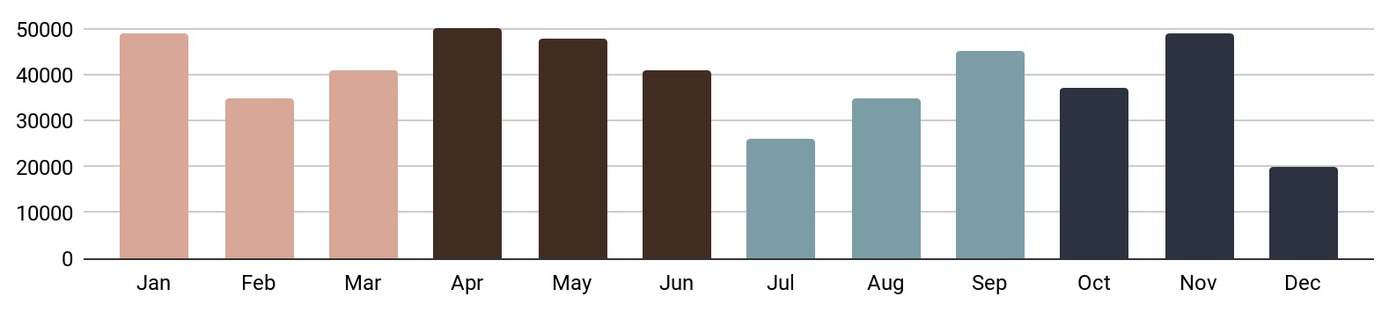
Quarterly Business Review Infographics
First Goal
Second Goal
Third Goal
Final Goal
Q1
Q2
Q3
Final Goal
Jupiter is the biggest planet of them all
Neptune is actually made of ice
Saturn is a gas giant and has several rings
Uranus is the seventh planet from the Sun

Slide 3
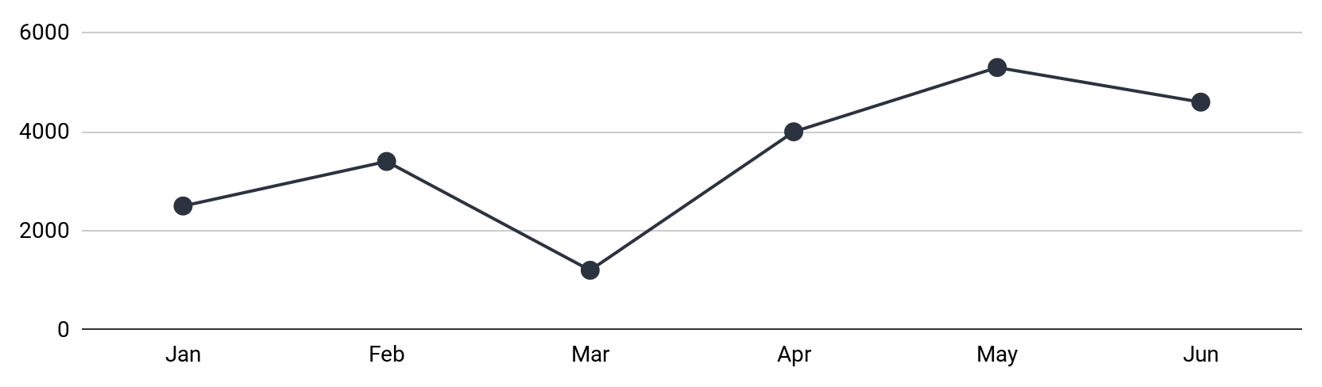
Quarterly Business Review Infographics
Last Quarter’s Analysis
Sales
Jupiter
68%
Mars
40%
Venus
89%
Q1
Q2
Q3
Moon
54%
$79,634
$74,654
$81,344

Slide 4
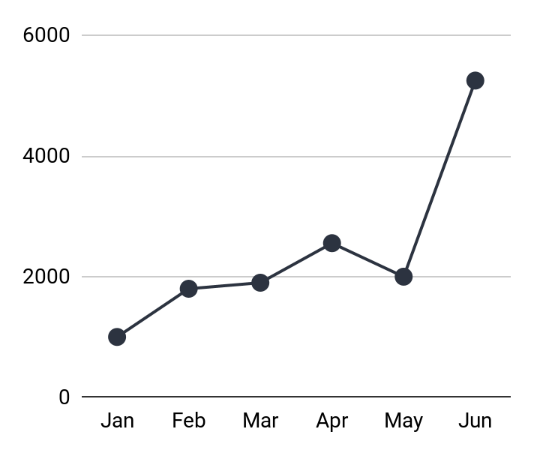
Quarterly Business Review Infographics
Last Quarter's Analysis
Competitors
Q2 Projection
Jupiter is the biggest and largest planet of them all
51%
24%
5254
2556
25%
Jupiter
Mercury
Jul
Aug
Sep
Mars is the fourth planet from the Sun and it’s a cold place
Saturn

Slide 5
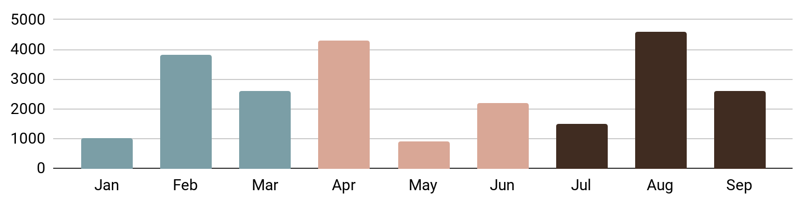
Quarterly Business Review Infographics
Q1
Q2
Q3
$4984
$2056
$1334
75%
Last Quarter's Analysis
Jupiter is the biggest planet
Q1
Q2
25%
Neptune is made of ice
Q3

Slide 6
Quarterly Business Review Infographics
Q1 Analysis
Pluto
10,324
0.56
25%
Neptune
Mars
5,324
Mars is cold
48%
Jupiter
Saturn
13,454
0.23
27%
Mercury
Mercury
7,324
Venus is hot
Q1
Total
Q2
Total
Jupiter is the fifth planet from the Sun and the biggest of them all
20,324
Mars is the fourth planet from the Sun and it’s a cold place
45,658

Slide 7
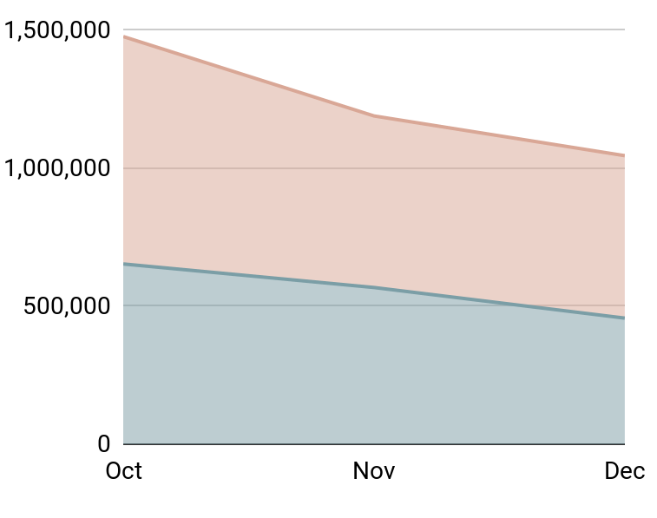
Quarterly Business Review Infographics
Q4 Revenue Goal vs Actual
Mercury is the smallest planet in the Solar System and the closest to the Sun. Its orbit around the Sun takes 87.97 Earth days, the shortest of all the Sun's planets. It is named after the Roman god Mercurius
Goal
Actual
REVENUE | OCT | NOV | DEC | TOTAL
Goal | 652,874 | 567,583 | 456,721 | 1,677,178
Actual | 823,563 | 621,321 | 588,327 | 2,033,211
Difference | 170,689 | 53,738 | 131,606 | 356,033
% to goal | 126% | 109% | 129% | 121%

Slide 8
Quarterly Business Review Infographics
Performance
Income
Goal
$7687
75%
Actual
Q1 revenue
October
November
December
Engagement
30%
Q1 Analysis
Jupiter
69%
Pluto
45%
Followers
Neptune
84%
2575
Saturn
59%

Slide 9
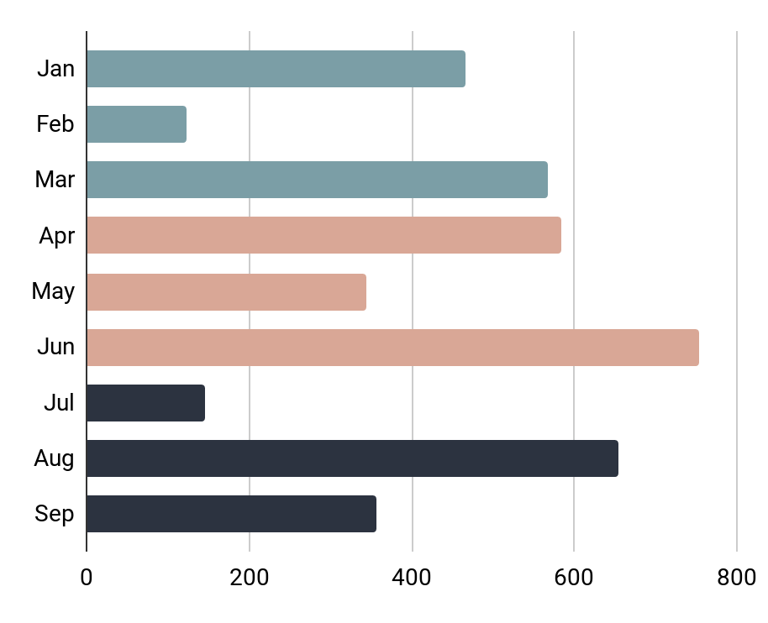
Quarterly Business Review Infographics
Q1
Jupiter is the fifth planet from the Sun and the biggest of them all
Q2
Mars is the fourth planet from the Sun and it’s actually a cold place
Q3
Saturn is the only planet with rings in the entire Solar System

Slide 10
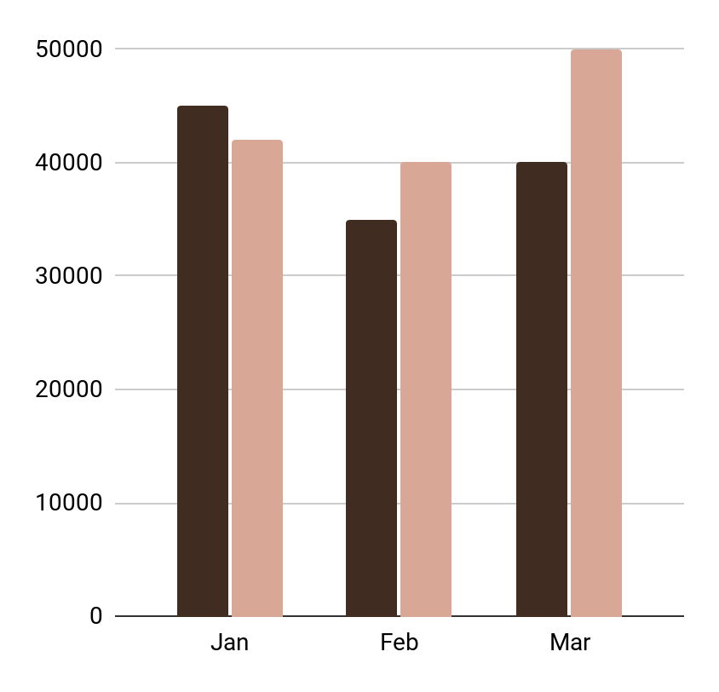
Quarterly Business Review Infographics
New Customers
Goal vs Actual
Sales
5647
Sales Revenue
$3456
38%
Neptune
Downloads
26%
Jupiter
2135
Goal
Actual
36%
Mercury

Slide 11
Quarterly Business Review Infographics
Performance
Q1 Results
Q1 | Budget | Goal | Actual
Jupiter | $7430 | 8723 | 9871
Mars | $8710 | 9125 | 7812
Neptune | $2340 | 5423 | 6721
Sales
Followers
$4984
566
Growth
Average spent
30%
$67

Slide 12
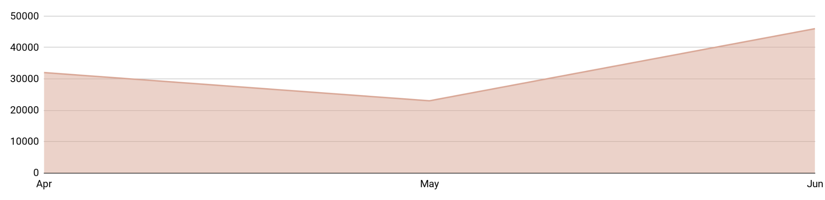
Quarterly Business Review Infographics
Shares
New followers
New buyers
+15%
+35%
+20%
Q2 Results
Jupiter is the fifth planet from the Sun and the biggest of them al

Slide 13
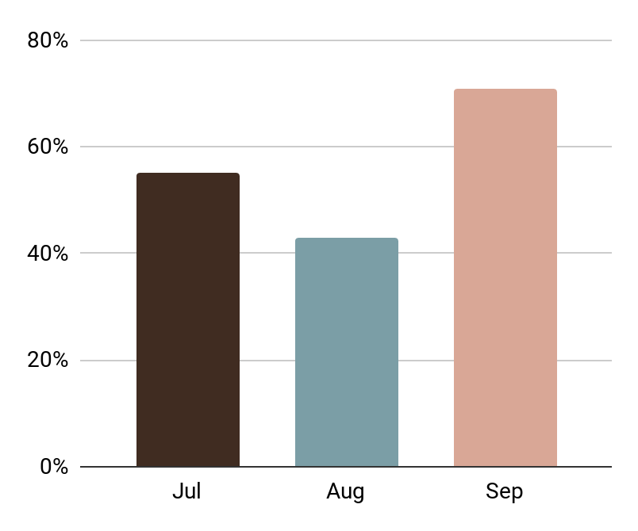
Quarterly Business Review Infographics
55%
Jupiter is the fifth planet from the Sun and the biggest of them all
43%
Mars is the fourth planet from the Sun and it’s a cold place
71%
The Earth is the only planet known to harbor life

Slide 14
Quarterly Business Review Infographics
World Q3 Office Performance
Statistics
Jupiter
88%
Mars
62%
Neptune
73%
Pluto
30%
Mercury
50%
Highest Revenue
Lowest Revenue
Earth
78%

Slide 15
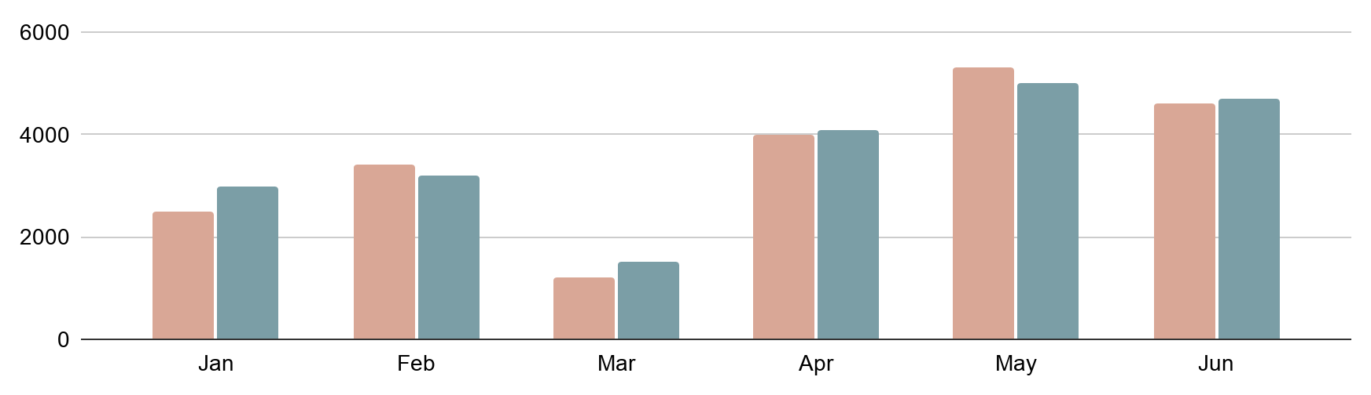
Quarterly Business Review Infographics
Goal vs Actual
Statistics
Goal
Jupiter
Actual
50%
Jupiter is the biggest planet of them all
Mars
75%
It’s the fourth planet from the Sun
Earnings
Downloads
Favorites
Neptune
$5692
12,984
1373
63%
It’s the farthest planet from the Sun

Slide 16
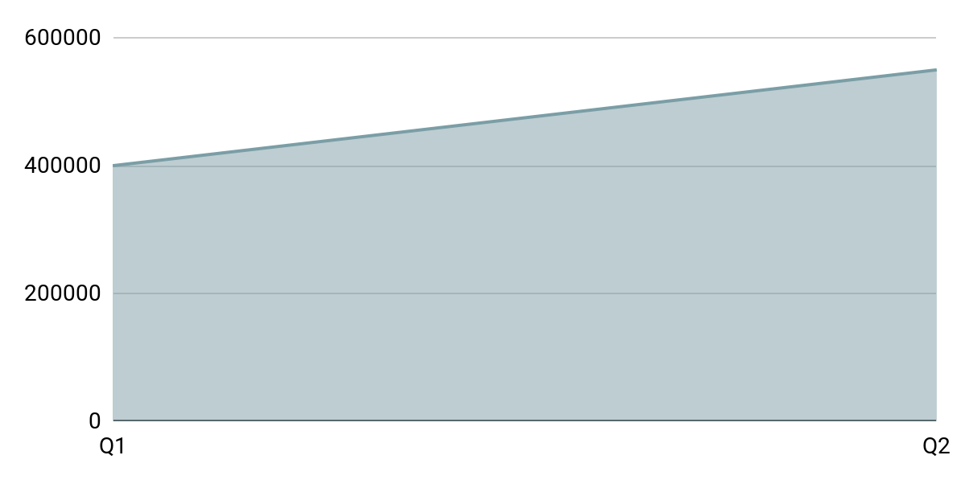
Quarterly Business Review Infographics
Statistics
Q1 Goal
Mercury is the smallest planet in the Solar System and the closest to the Sun. Its orbit around the Sun takes 87.97 Earth days, the shortest of all the Sun's planets. It is named after the Roman god Mercurius
$400,000
Q2 Projection
25%
50%
67%
75%
Jupiter is the biggest planet
Neptune is made of ice
Saturn is the only with rings
Mars is actually cold
$550,000

Slide 17
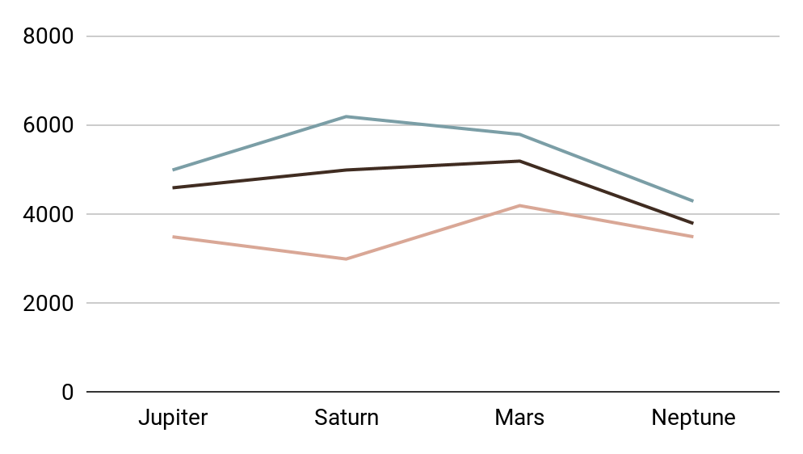
Quarterly Business Review Infographics
Q3 Performance
Income results
Jupiter is the fifth planet from the Sun and the biggest of them all
Saturn is the only planet in the entire Solar System that as a ring system. It’s also a gas giant!
Jupiter
20%
23%
Mars
12%
Neptune
45%
Saturn
Q1
Q2
Q3

Slide 18
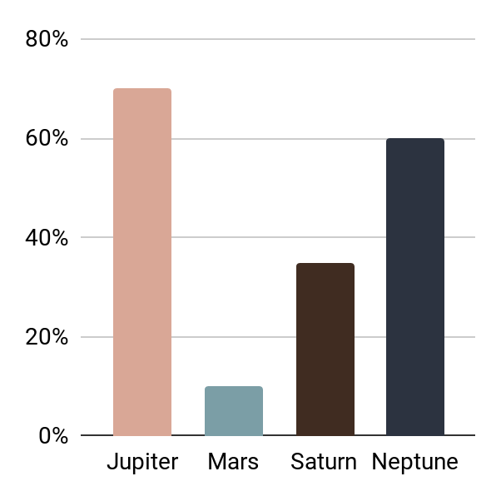
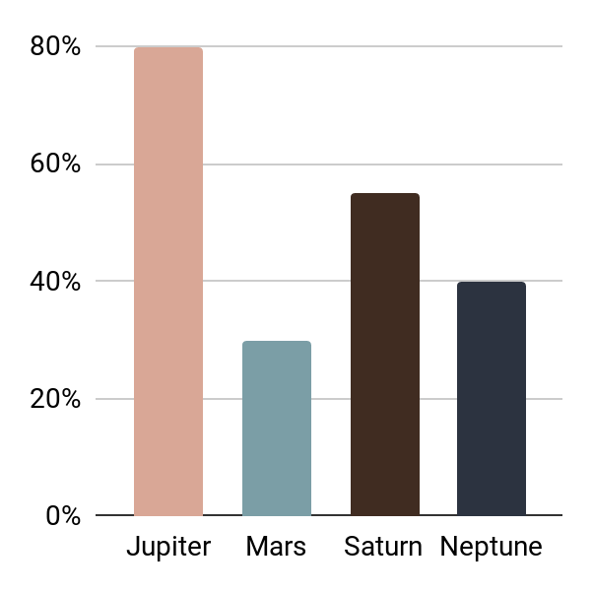
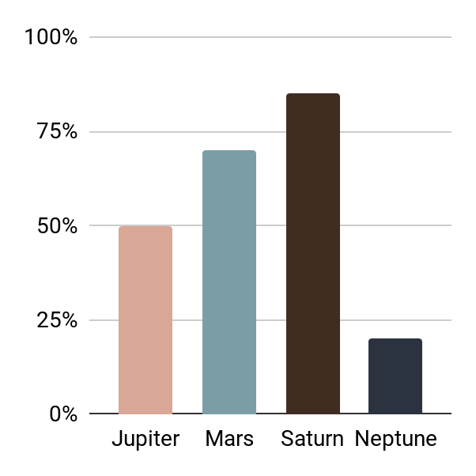
Quarterly Business Review Infographics
Q1 Statistics
Q2 Statistics
Q3 Statistics
Jupiter is the biggest planet of them all
Neptune is the farthest planet from the Sun
Despite being red, Mars is actually a cold place

Slide 19
Quarterly Business Review Infographics
Q2 Statistics
Competitors
Venus
Mercury is the closest planet to the Sun
56%
73%
Jupiter is the biggest planet
Mars
85%
Despite being red, it’s actually a cold place
Neptune is made of ice
89%
Earth
40%
It’s the third planet from the Sun
Saturn is a gas giant with rings
60%

Slide 20
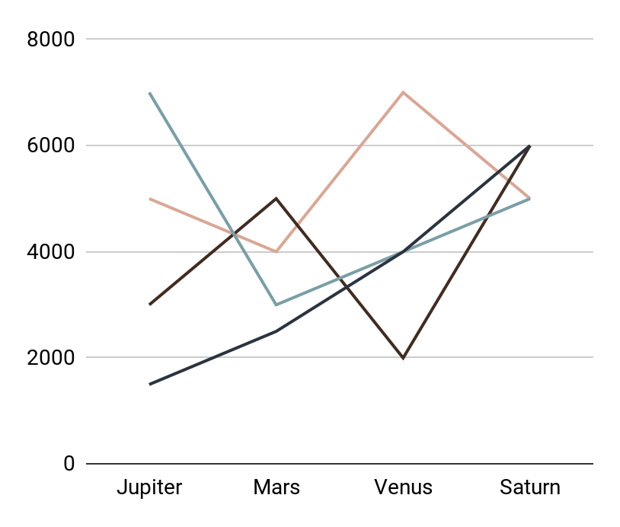
Quarterly Business Review Infographics
Q1
Q3
Jupiter is the fifth planet from the Sun and the biggest of them all
Mars is the fourth planet from the Sun and it’s actually a cold place
Q2
Final Goal
Neptune is a gas giant with an average radius of about nine times the Earth's
Neptune is the eighth and farthest-known solar planet from the Sun

Slide 21
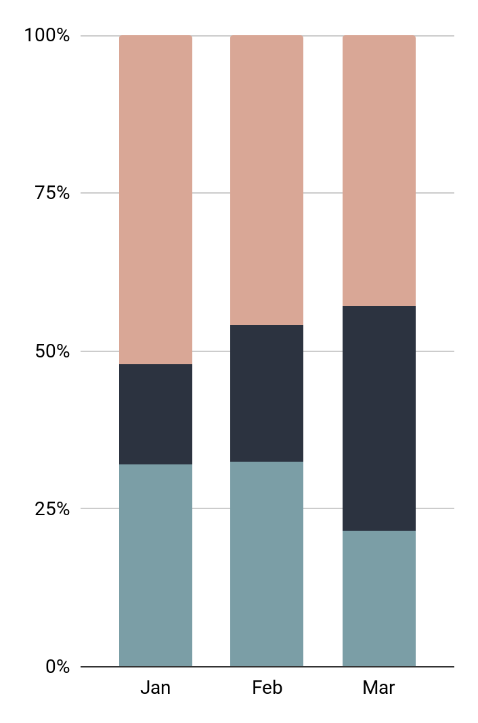
Quarterly Business Review Infographics
Q3 Statistics
Sales
Venus
25%
Venus is the closest planet to the Sun
Jupiter
Jupiter is the biggest planet of them all
Growth
Mars
Despite being red, it’s actually a cold place
50%

Slide 22
Quarterly Business Review Infographics
Sales
Profit
New Customers
Q2 Projection
$7634
$2487
2344
$8360
Q1 Revenue
25%
13%
62%
Jupiter is the fifth planet from the Sun and the biggest of them all
Saturn is a gas giant with a radius of about nine times the Earth's
Mars is the fourth planet from the Sun and it’s a cold place

Slide 23
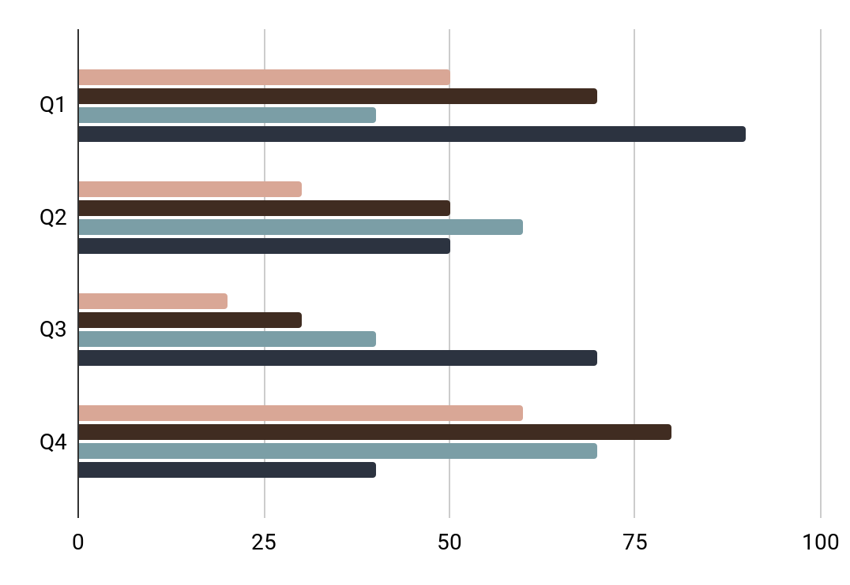
Quarterly Business Review Infographics
Jupiter
Neptune
Jupiter is the biggest planet
Neptune is made of ice
Saturn
Mars
It’s a gas giant and has rings
Despite being red, it’s cold

Slide 24
Quarterly Business Review Infographics
Sales Statistics
Q2 Review
65%
80%
Jupiter is the biggest planet
Saturn is a gas giant with rings
37%
25%
Apr
May
Jun
Neptune is made of ice
Mars is actually cold
It’s a gas giant with an average radius of about nine times the Earth's

Slide 25
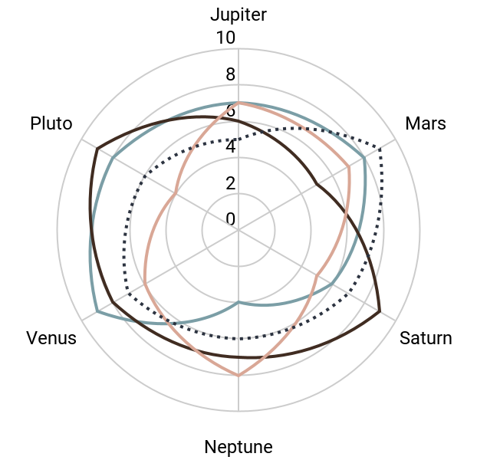
Quarterly Business Review Infographics
Q1
Q3
Jupiter is the fifth planet from the Sun and the biggest of them all
Mars is the fourth planet from the Sun and it’s actually a cold place
Q2
Q4 Projection
Saturn is a gas giant with an average radius of about nine times the Earth's
Neptune is the eighth and farthest-known solar planet from the Sun

Slide 26
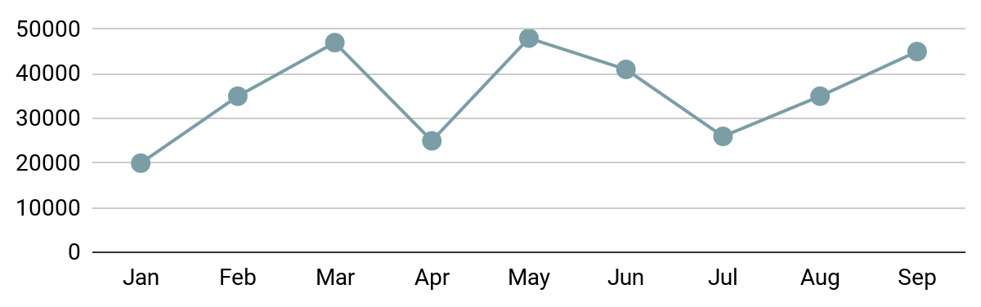
Quarterly Business Review Infographics
Q1
Q2
Q3 Growth
$3485
$2736
Q3 Sales Statistics
20%
Neptune
37%
Jupiter
21%
Mars
22%
Saturn

Slide 27
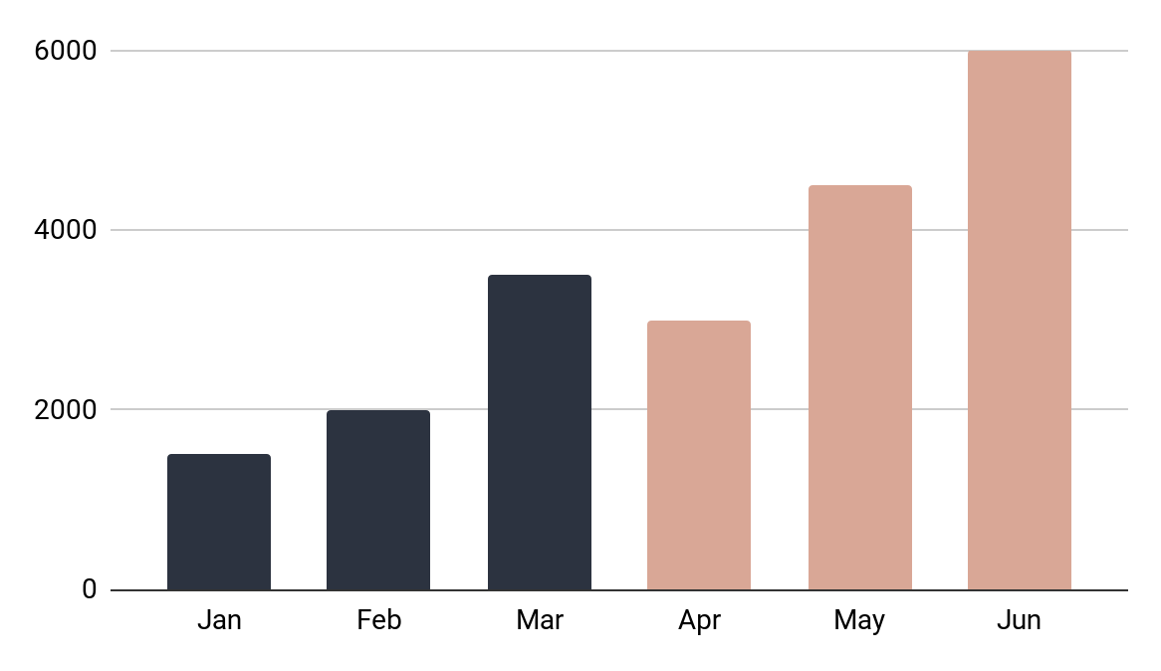
Quarterly Business Review Infographics
Statistics
Last Quarter's Analysis
Jupiter
+10%
Jupiter is the biggest planet of them all
Mars
+8%
Despite being red, it’s actually a cold place
Venus
+12%
Venus is the closest planet to the Sun

Slide 28
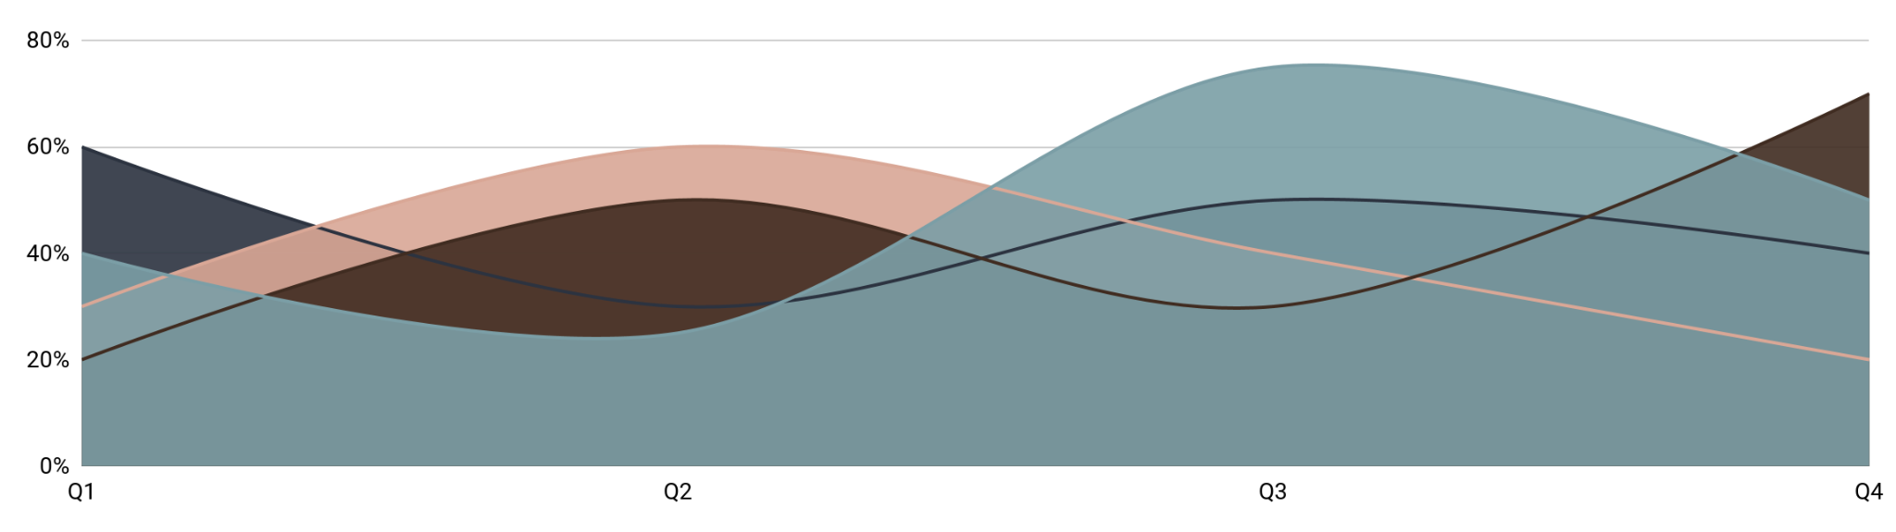
Quarterly Business Review Infographics
Jupiter
Venus
Mars
Saturn
Jupiter is the biggest planet of them all
Venus is the closest planet to the Sun
Despite being red, it’s actually a cold place
It’s the only planet with rings

Slide 29
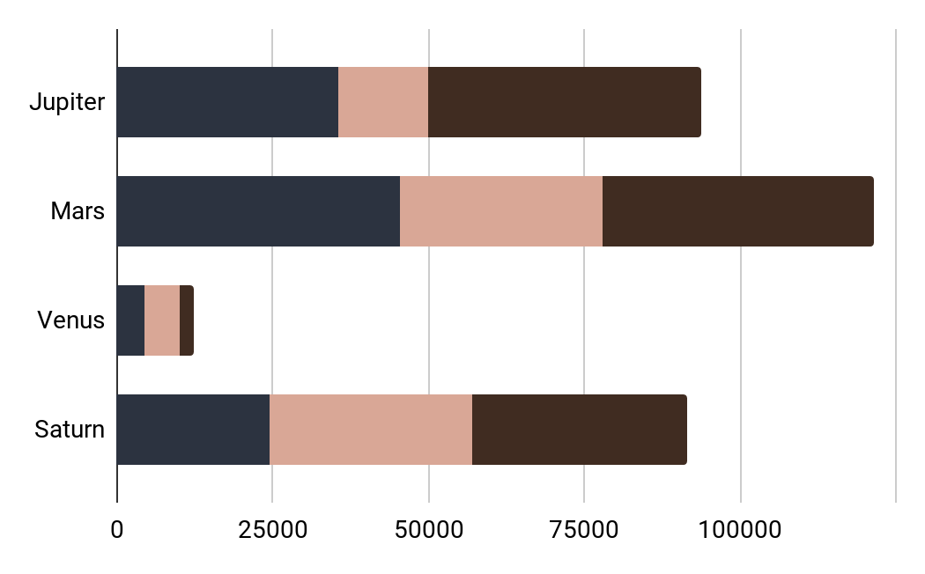
Quarterly Business Review Infographics
Q1 Sales
Statistics
 | Jan | Feb | Mar
Mars | 324,535 | 214,324 | 346,550
Venus | 5723 | 2144 | 3254
Saturn | 23,414 | 45,698 | 34,567
Pluto | 35,434 | 46,579 | 54,754
January
February
March

Slide 30
Quarterly Business Review Infographics
Q2 Performance
Statistics
74%
37%
Jupiter is the biggest planet
Only Saturn has ring
84%
56%
Neptune is made of ice
Despite being red, it’s cold
Sales
Revenue
Mars is cold despite its reddish color
75%
Venus has a beautiful name and it’s hot
64%
Apr
May
Jun
68%
86%
42%

Slide 31
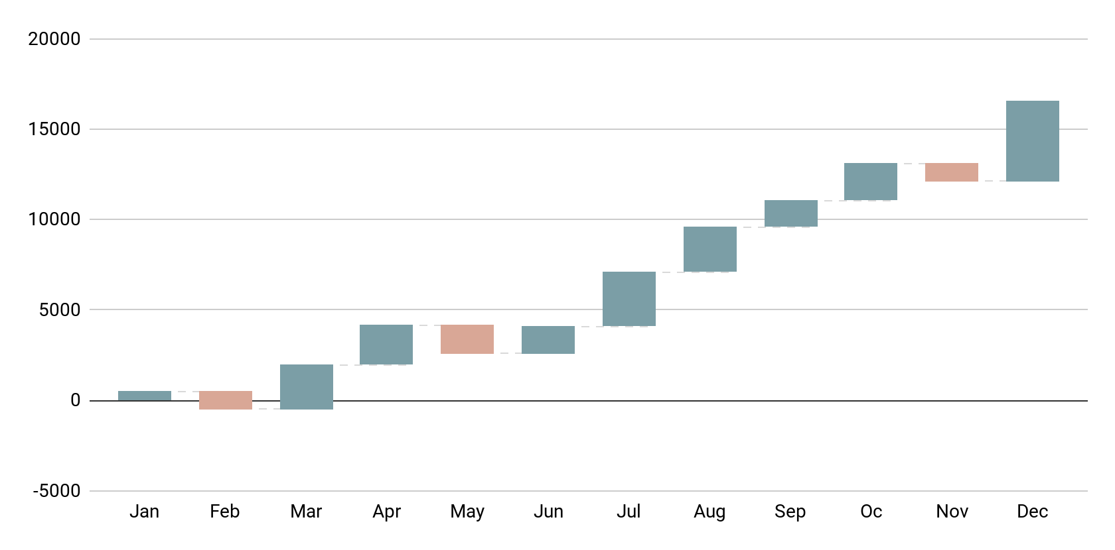
Quarterly Business Review Infographics
Q1 to Q4 Review
Positive
Jupiter is the fifth planet from the Sun and the biggest of them all
Negative
Saturn is a gas giant with a radius of about nine times the Earth's

Slide 32
Instructions for use (premium users)
In order to use this template, you must be a Premium user on Slidesgo.
You are allowed to:
Modify this template.
Use it for both personal and commercial purposes.
Hide or delete the “Thanks” slide and the mention to Slidesgo in the credits.
Share this template in an editable format with people who are not part of your team.
You are not allowed to:
Sublicense, sell or rent this Slidesgo Template (or a modified version of this Slidesgo Template).
Distribute this Slidesgo Template (or a modified version of this Slidesgo Template) or include it in a database or in any other product or service that offers downloadable images, icons or presentations that may be subject to distribution or resale.
Use any of the elements that are part of this Slidesgo Template in an isolated and separated way from this Template.
Register any of the elements that are part of this template as a trademark or logo, or register it as a work in an intellectual property registry or similar.
For more information about editing slides, please read our FAQs or visit Slidesgo School:
https://slidesgo.com/faqs and https://slidesgo.com/slidesgo-school

Slide 33
Infographics
You can add and edit some infographics to your presentation to present your data in a visual way.
Choose your favourite infographic and insert it in your presentation using Ctrl C + Ctrl V or Cmd C + Cmd V in Mac.
Select one of the parts and ungroup it by right-clicking and choosing “Ungroup”.
Change the color by clicking on the paint bucket.
Then resize the element by clicking and dragging one of the square-shaped points of its bounding box (the cursor should look like a double-headed arrow). Remember to hold Shift while dragging to keep the proportions.
Group the elements again by selecting them, right-clicking and choosing “Group”.
Repeat the steps above with the other parts and when you’re done editing, copy the end result and paste it into your presentation.
Remember to choose the “Keep source formatting” option so that it keeps the design. For more info, please visit Slidesgo School.

